Slide 1
Model space now: Existing and j, y, k
17/3/15

Slide 2
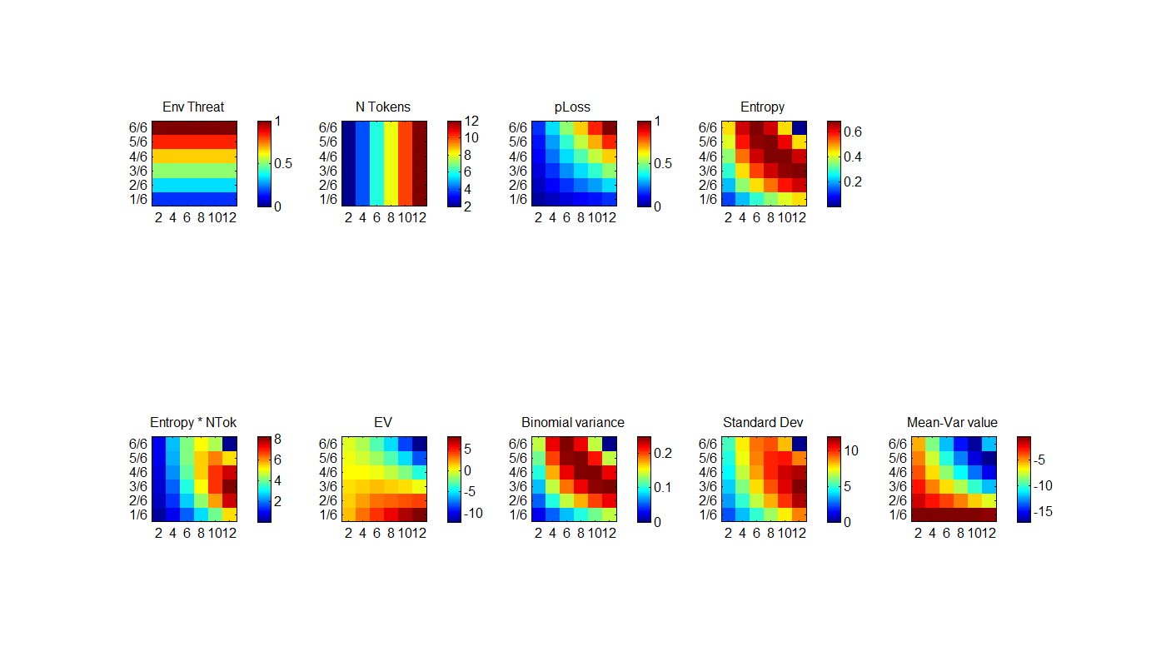
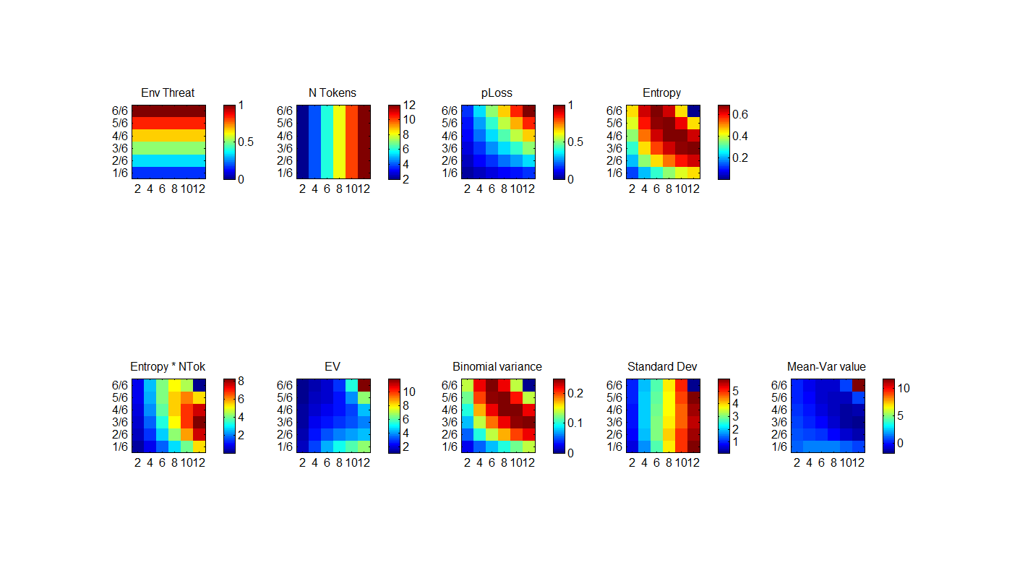
Defined quantities
Experimental
Control

Slide 3
Winning models

Slide 4
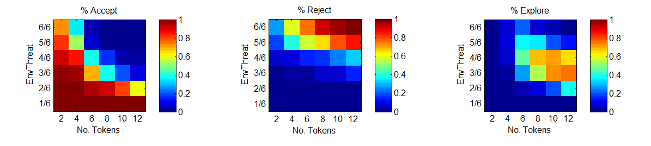
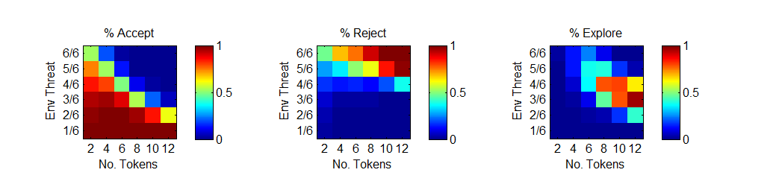
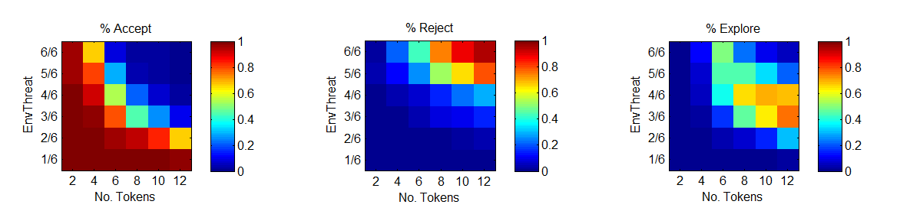
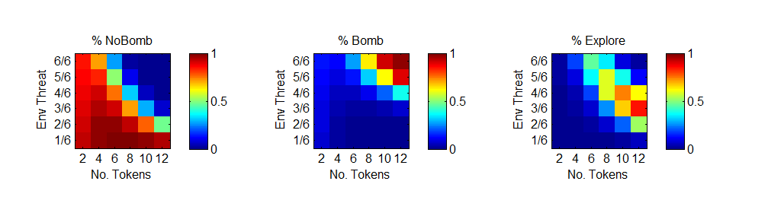
Predicted vs observed choice
Observed
Predicted
cF
ct
Observed
Predicted
Notes:
cF:bpm16
Ct: bpmi11

Slide 5
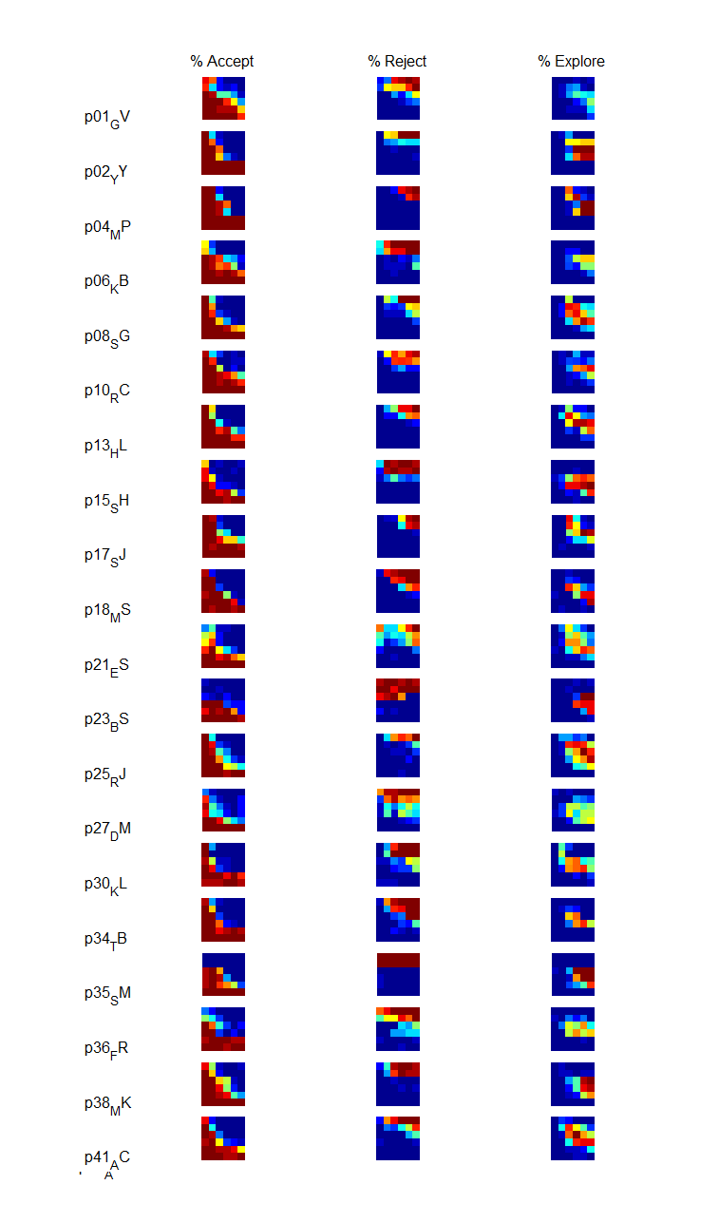
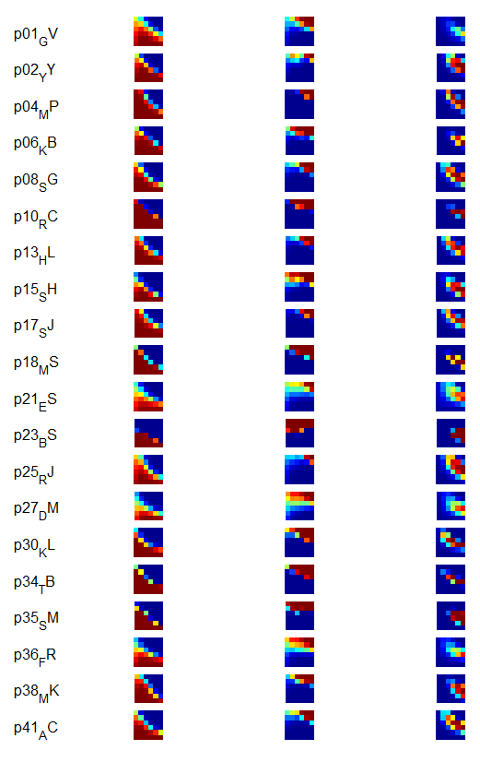
Captures individual difference [cF]
Observed Predicted
Experimental task

Slide 6
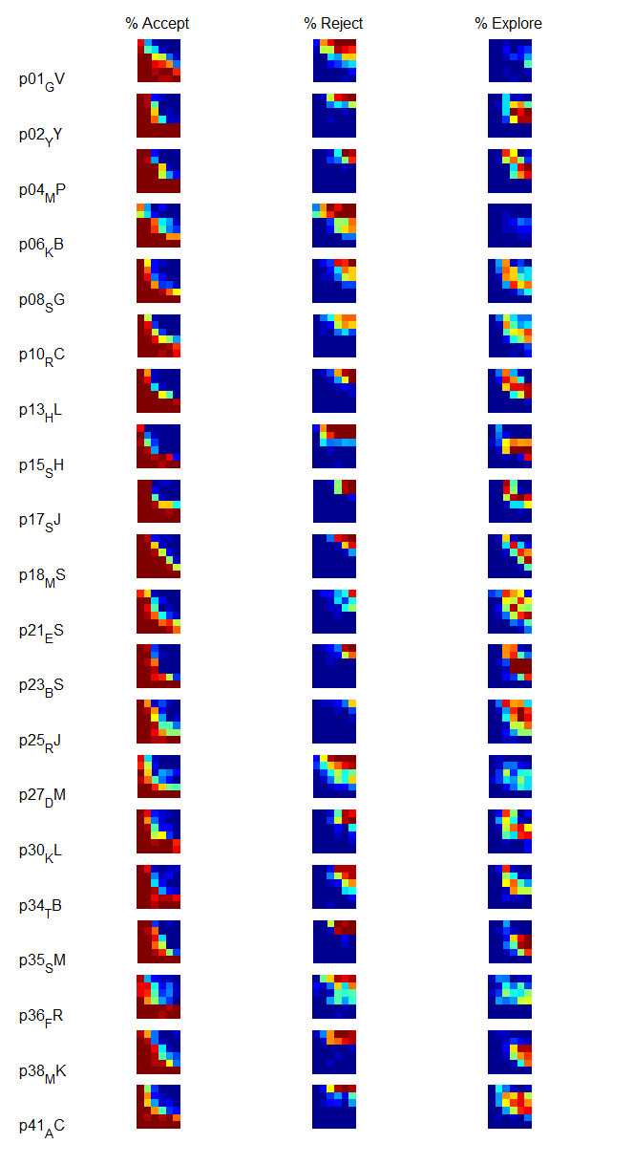
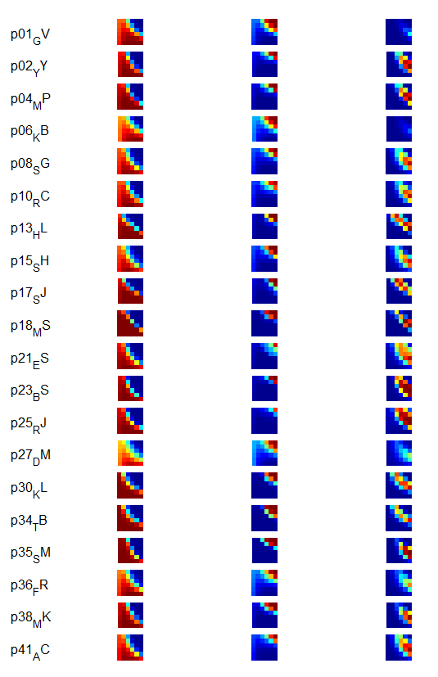
Captures individual difference [ct]
Observed Predicted
Control task
Notes:
bpmi11

Slide 7
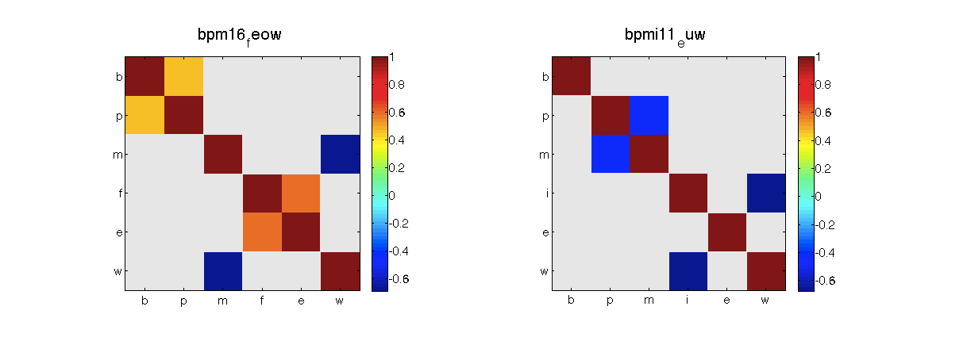
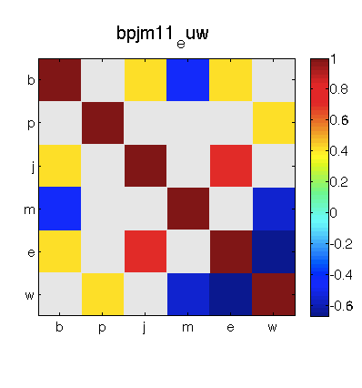
Parameters trading off?

Slide 9
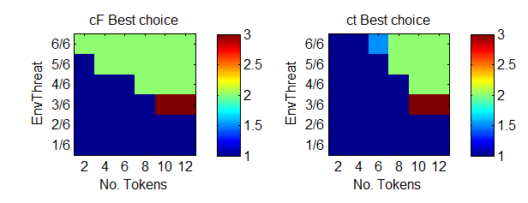
What’s the optimal thing to do?
Optimal from Dayan’s code
Baby blue: A/R draw
Neon blue: A/E draw
Orange: R/E draw

Slide 10
Sanity checks

Slide 11
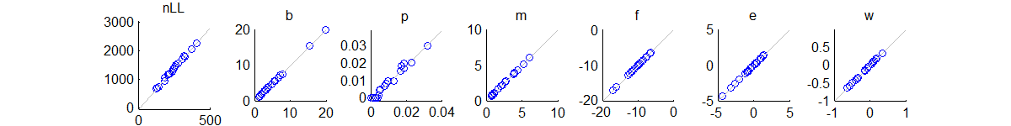
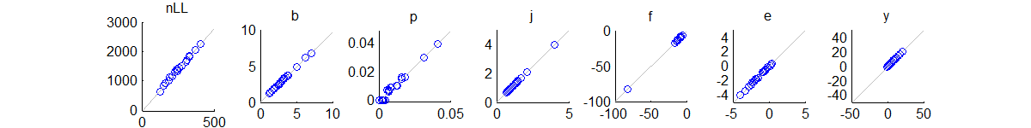
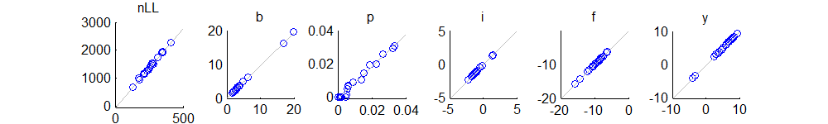
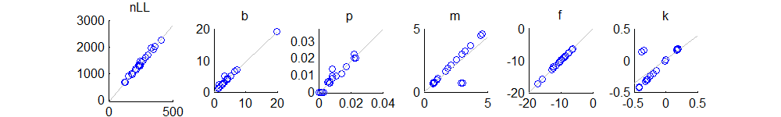
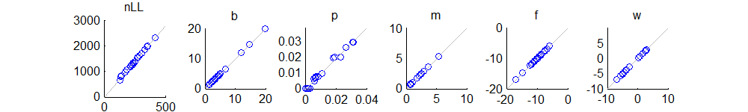
cF - Simulations refit
bpm16
bpj20
bpi18
bpm22
bpm08

Slide 12
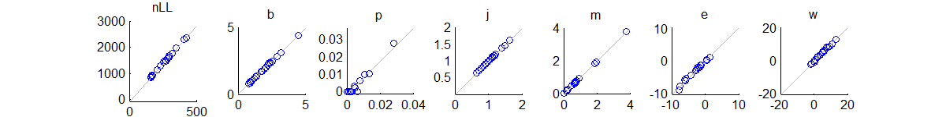
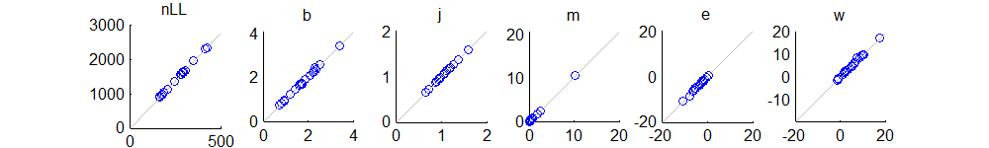
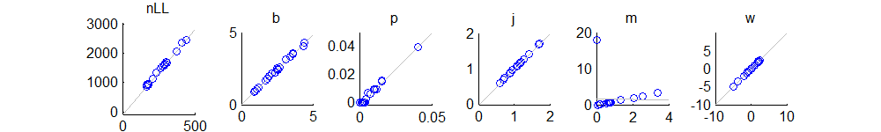
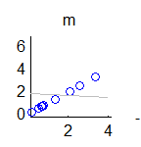
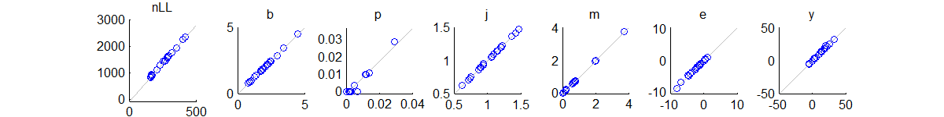
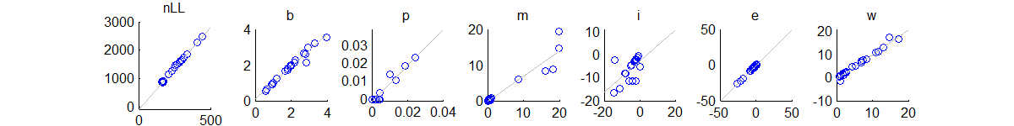
ct - Simulations refit
bpjm11
bjm11
bpjm04
bpjm19
bpmi11

